Slide 1
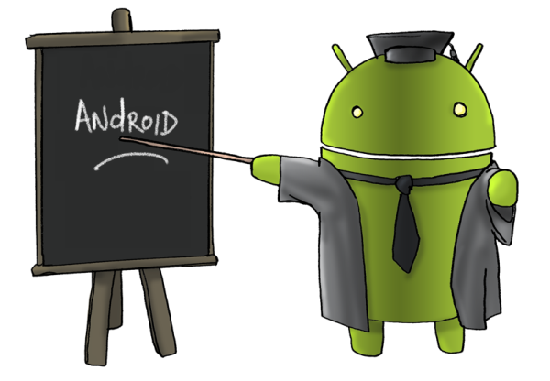
Simple Android Application
Eng. Basma Hassan
Eng. Samar Shaban

Slide 2
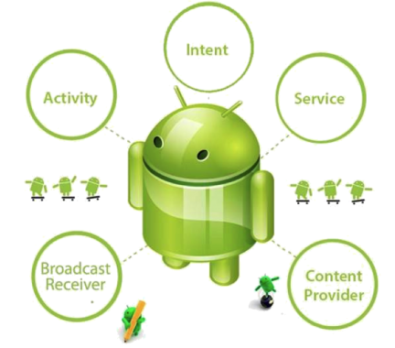
Android App Components

Slide 3
Android App Components
Activity
the basis of android applications.
Service
a component that runs in the background (music play)
Content Providers
manages a shared set of app data (user's contact information)
Broadcast Receivers
a component that responds to system-wide broadcast announcements (screen has turned off, the battery is low)
Intent
a messaging object you can use to request an action from another app component.

Slide 4
Activity
An activity represents a single screen with a UI.
Application can have multiple activities.
Email app activities: List mails, compose mail, read mail.
Each activity is a separate entity and independent of the others.
A different app can start any one of these activities.
Camera app starts compose activity in Email app.
An activity is implemented as a subclass of Activity
They have a structured life cycle.
Notes:
An activity represents a single screen with a user interface. For example, an email app might have one activity that shows a list of new emails, another activity to compose an email, and another activity for reading emails. Although the activities work together to form a cohesive user experience in the email app, each one is independent of the others. As such, a different app can start any one of these activities (if the email app allows it). For example, a camera app can start the activity in the email app that composes new mail, in order for the user to share a picture.An activity is implemented as a subclass of Activity and you can learn more about it in the Activitiesdeveloper guide.

Slide 5
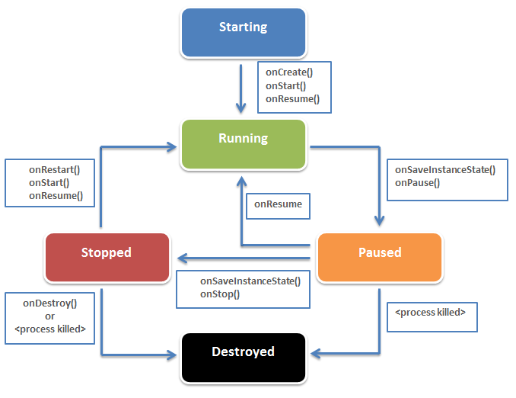
Activity Lifecycle

Slide 6
Activating Components
Start an activity (or give it something new to do)
passing an Intent to startActivity() or startActivityForResult() (when you want the activity to return a result).
Start a service (or give new instructions to an ongoing service)
passing an Intent to startService(). Or you can bind to the service by passing an Intent to bindService().
Initiate a broadcast
passing an Intent to methods like sendBroadcast(), sendOrderedBroadcast(), or sendStickyBroadcast().
Perform a query to a content provider
calling query() on a ContentResolver.

Slide 7
Manifest File
Read by Android system to know the app’s components before starting it.
MUST be located at the root of the app project directory.
Contains characteristics about your application.
Any app must declare all its components in it
Activities, Services, Content Providers, and Broadcast Receivers
Declaring component capabilities
Intent-filters
Declaring app requirements and permissions
camera, Google Maps API, monitor incoming SMS messages … etc.

Slide 8
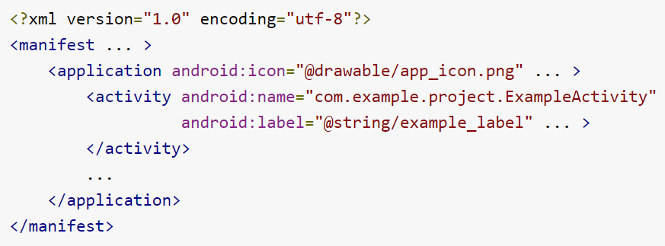
Manifest File

Slide 9
App Resources
Anything relating to the visual presentation of the app separate from the source code
images, audio files, etc.
Easy to update various characteristics of the app without modifying code .
Enables optimization of the app for a variety of device configurations
different languages, and screen sizes.
Every resource is defined by a unique integer ID used to reference the resource from the app code.
image “logo.png” (in res/drawable/ ) → ID: R.drawable.logo

Slide 10
First Android App

Slide 11
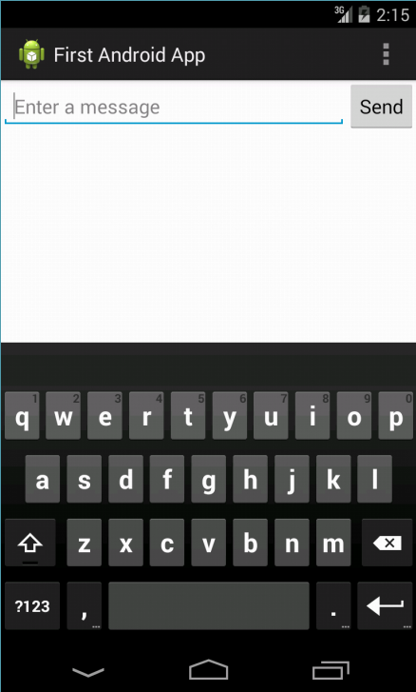
First Android App (1)
Building a simple User Interface
Create a Linear Layout
Add a Text Field
Add String Resources
Add a Button
Make the Input Box Fill in the Screen Width
Run Your App

Slide 12

To be continue…

Slide 13
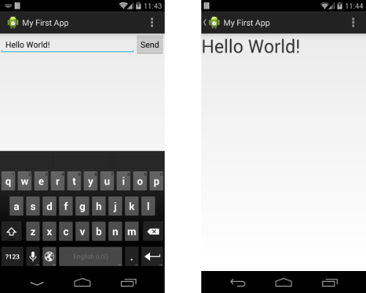
First Android App (2)
Starting another activity
Create the Second Activity
Respond to the Send Button
Build an explicit Intent
Receive the Intent
Display the Message

Slide 14
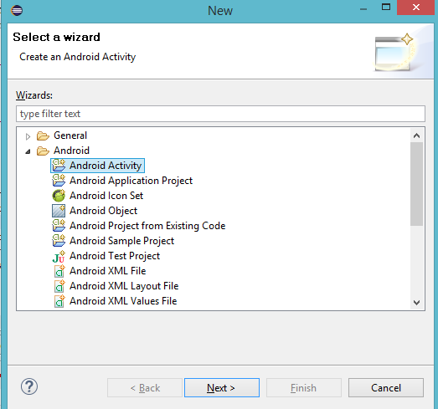
Create Second Activity
In Eclipse:
File → New → Other…
OR, Ctrl+N
Select “Android Activity”
Name this Activity
“DisplayMessageActivity”
Modify the TextView:
Set “textSize” to 40sp
Set “layout_centerHorizontal” to true (Optional)

Slide 15
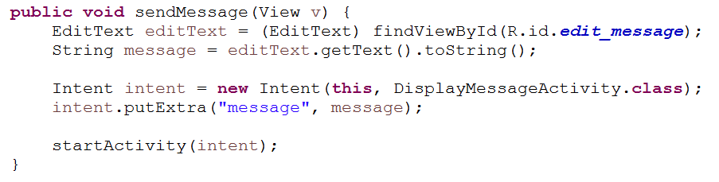
Send Button Action (MainActivity)
In MainActivity…
Get message entered by user.
Build an explicit intet
Start the DisplayMessageActivity
1
2
3

Slide 16
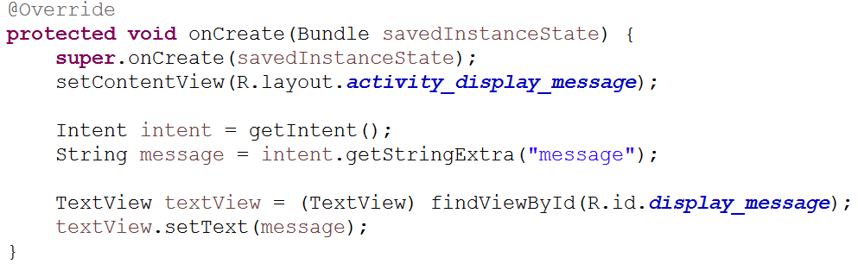
Receive and Display Message
In DisplayMessageActivity ….
Receive the Intent
Display the Message in TextView
1
2

Slide 17
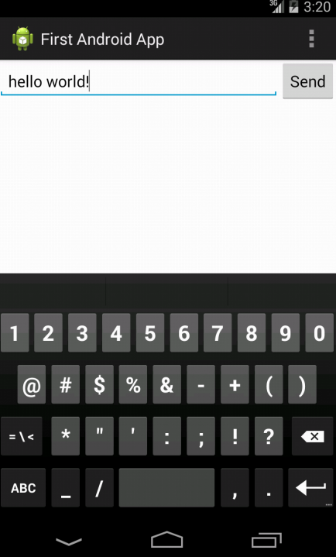
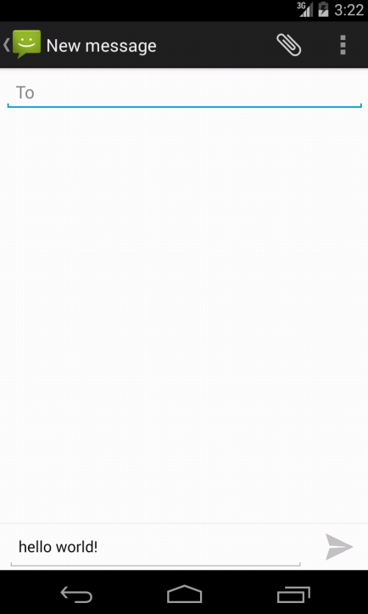
First Android App (3)
Starting the messaging app
Respond to the Send Button
Build an implicit Intent

Slide 18
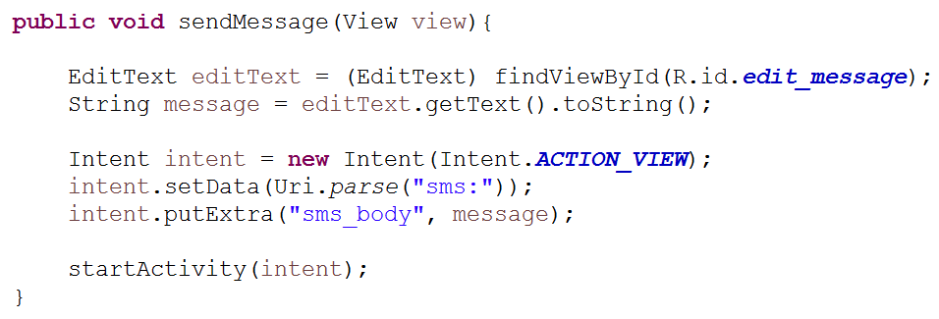
Send Button Action (MainActivity)
In MainActivity…
Get message entered by user.
Build an implicit intet
1
2
3

Slide 19
Run on Real Device
Plug in your device to your development machine with a USB cable.
Install the appropriate USB driver for your device.
Enable USB debugging on your device.
On Android 3.2 or older:
Settings > Applications > Development.
On Android 4.0 and newer:
Settings > Developer options
On Android 4.2 and newer, Developer options is hidden by default. To make it available,
go to Settings > About phone and tap Build number seven times.
Return to the previous screen to find Developer options.

Slide 20
We are now done with ANDROID

